Slide 1
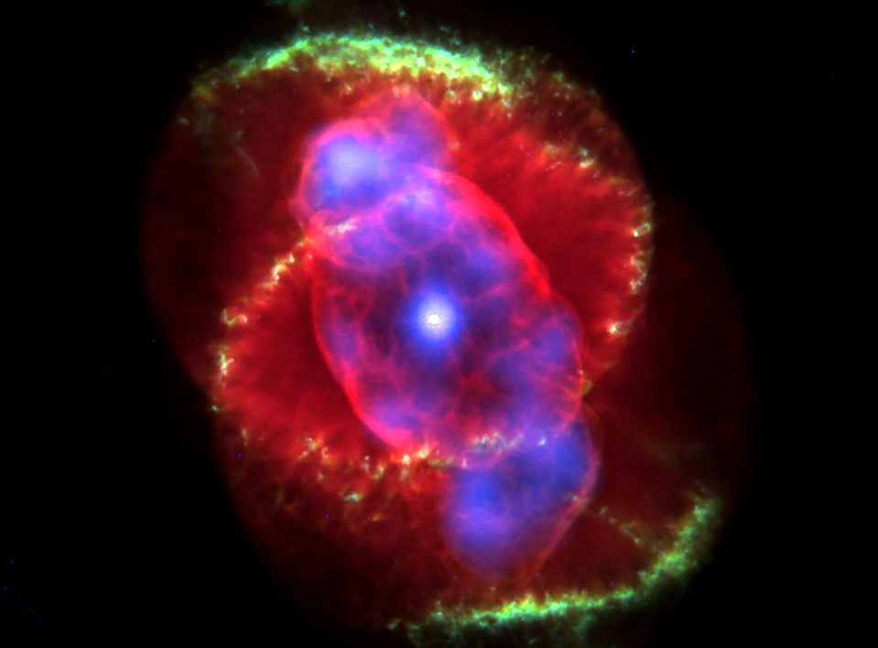
Cat’s Eye Nebula
a relatively bright planetary nebula in Draco

Slide 2
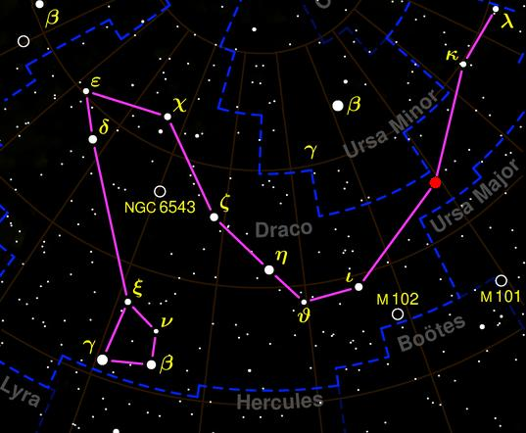
Cat’s Eye Nebula
Constellation: Draco

Slide 3

Cat’s Eye Nebula
It’s “cat’s eye” is due to a series of gas loops that have been ejected by the central star over the last 1,000 years or so.

Slide 4
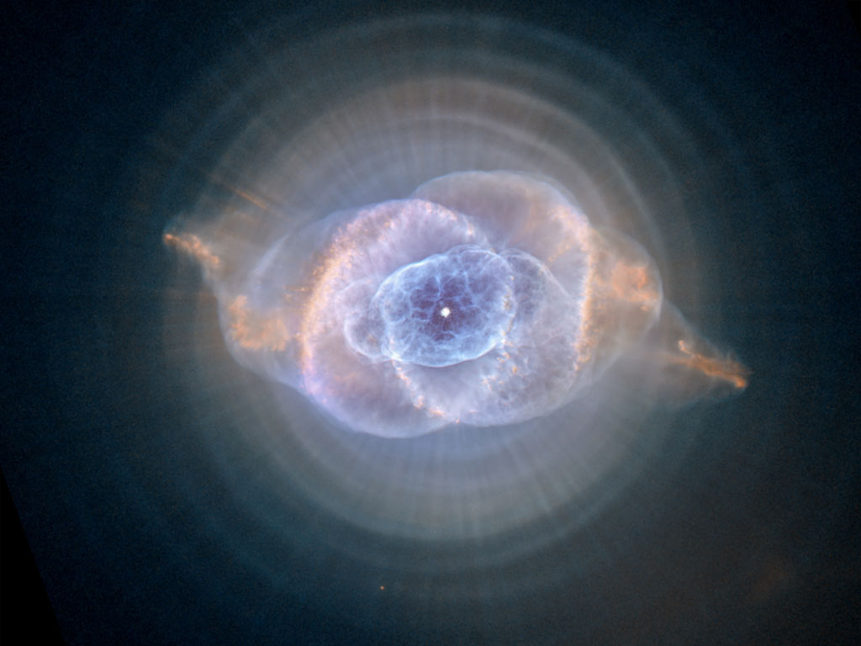
Cat’s Eye Nebula
It is one of the most complex nebula known, but very powerful instruments are needed to study its interior structure.

Slide 5
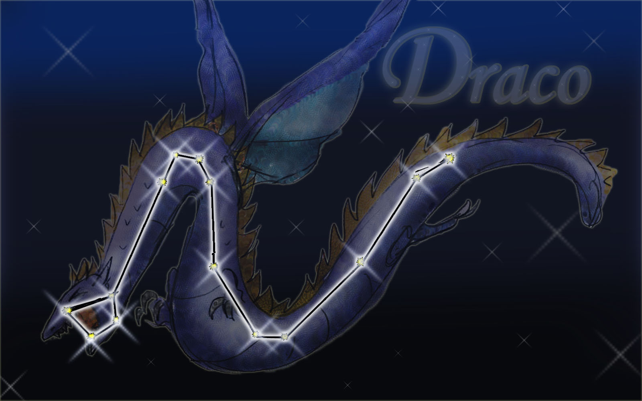
Cat’s Eye Nebula

Slide 6

This is a young planetary nebula. Astronomers think that the jets of high speed gas leading to its shape may suggest a binary star at its center. As the dying star would periodically release gas, the other star would rotate around it, pulling the gases in different directions.
Cat’s Eye Nebula

Slide 7
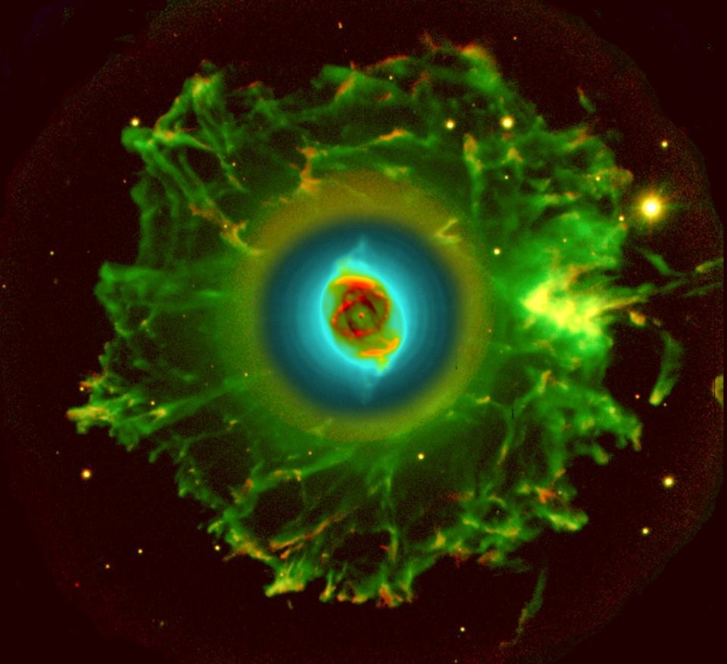
Cat’s Eye Nebula
First discovered by William Herschel on February 15, 1786.
It was the first planetary nebula to be investigated spectroscopically by English amateur astronomer William Huggins in 1864.

Slide 8
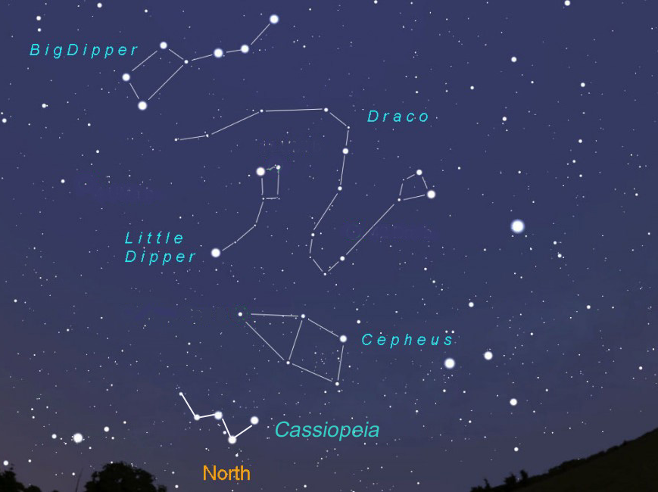
Cat’s Eye Nebula

Slide 9
Cat’s Eye Nebula
Hubble images reveal at least 11 concentric shells around the central portion. These suggest that the star ejects its mass at 1,500-year intervals. We are not certain why it would be doing this.

Slide 10
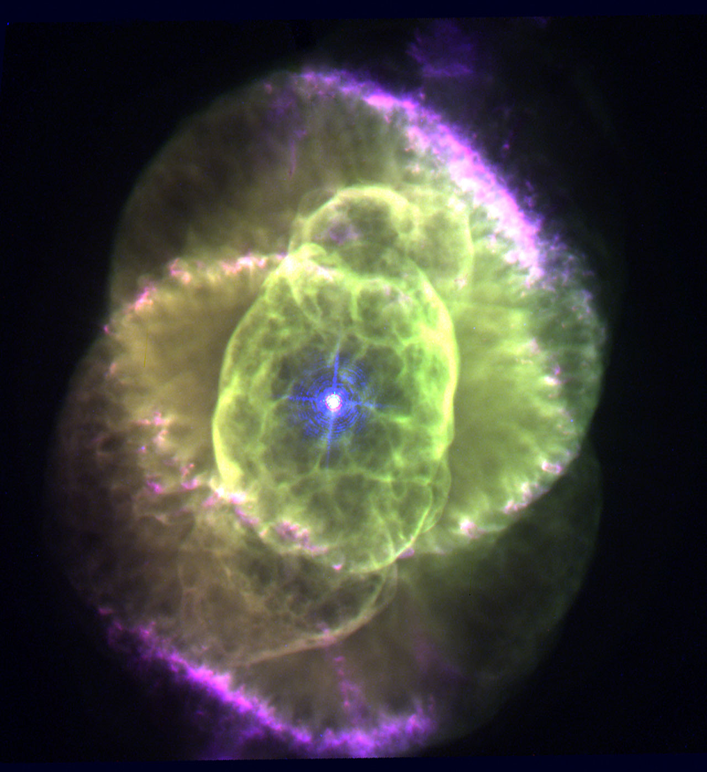
Cat’s Eye Nebula
It is currently expanding, although it is difficult to know how rapidly.

Slide 11
Cat’s Eye Nebula
Visual Magnitude: +8.10 (not visible to naked eye and best in large telescopes)
Apparent Size: 0.4 x 0.3 arcminutes

Slide 12
Cat’s Eye Nebula
Distance: 3,200 light years away
Diameter: 0.3 light years across

Slide 13
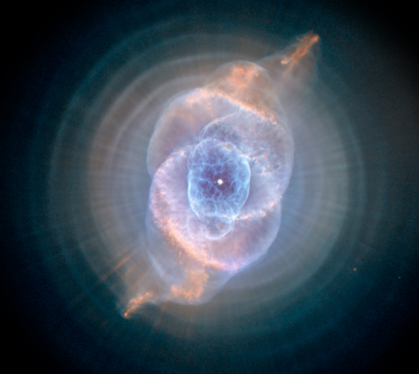

Planetary Nebula Basics

Slide 14
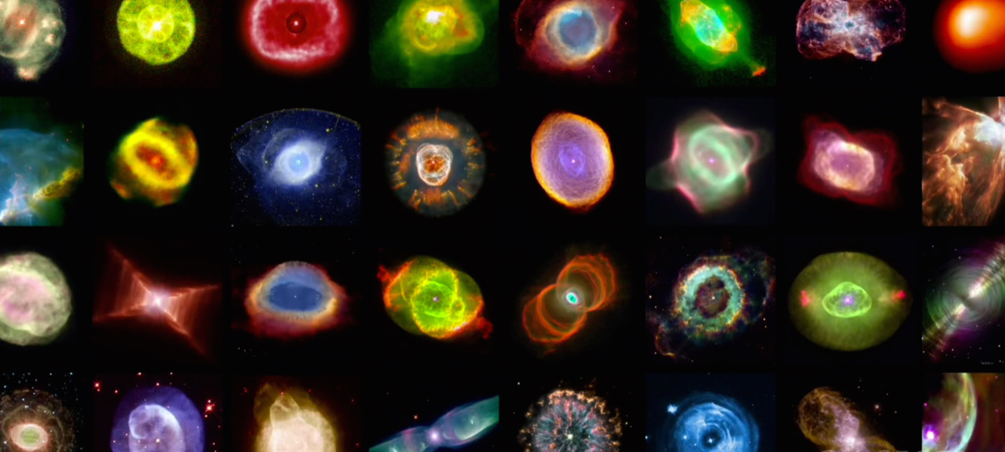
Planetary Nebula Basics
Planetary Nebula are the remains of a sun-like star that has used all of its hydrogen gas (fuel).

Slide 15
Planetary Nebula Basics
The Sun will become an object like this in 5 to 6 billion years.

Slide 16
Planetary Nebula Basics
The glowing gases were once thought to be planets in the process of forming, hence the name “planetary nebula”.

